Slide 1
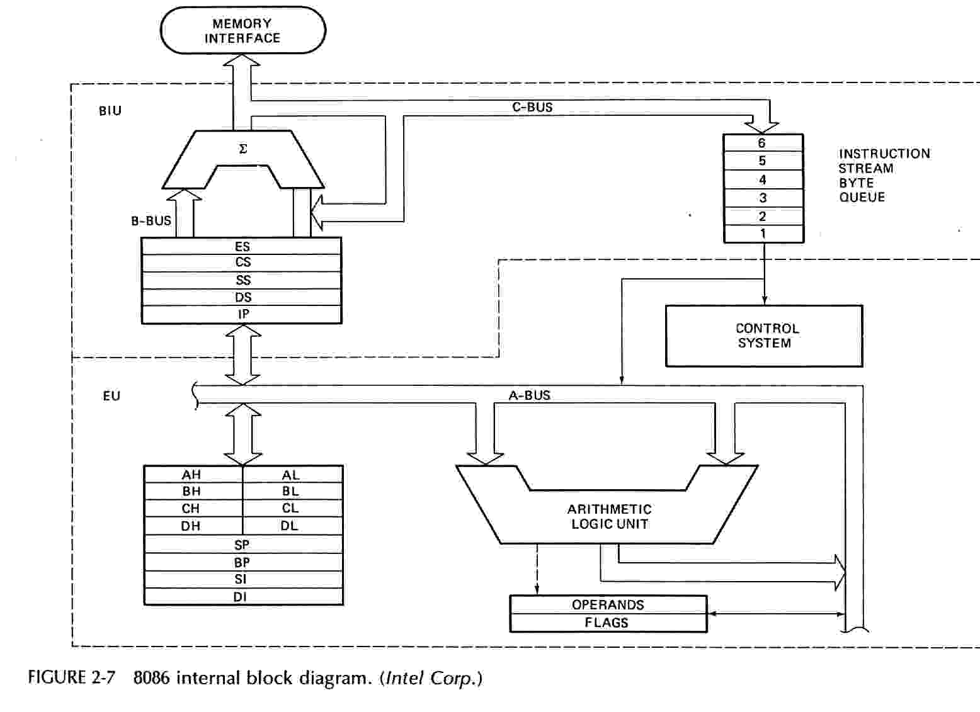
Block diagram of 8086

Slide 2
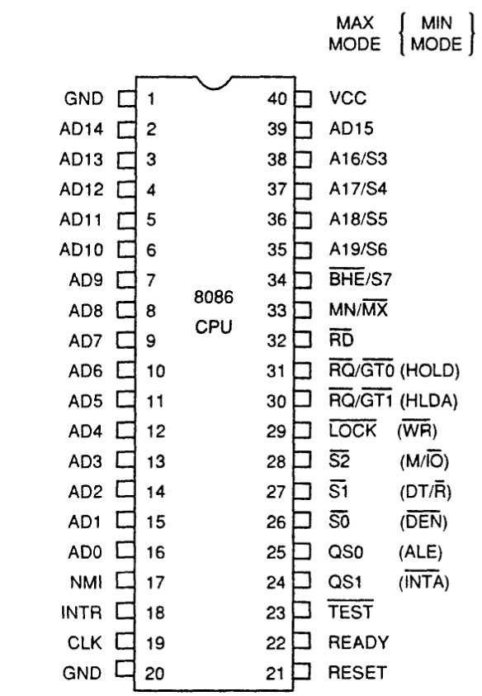
INTEL 8086 - Pin Diagram

Slide 3
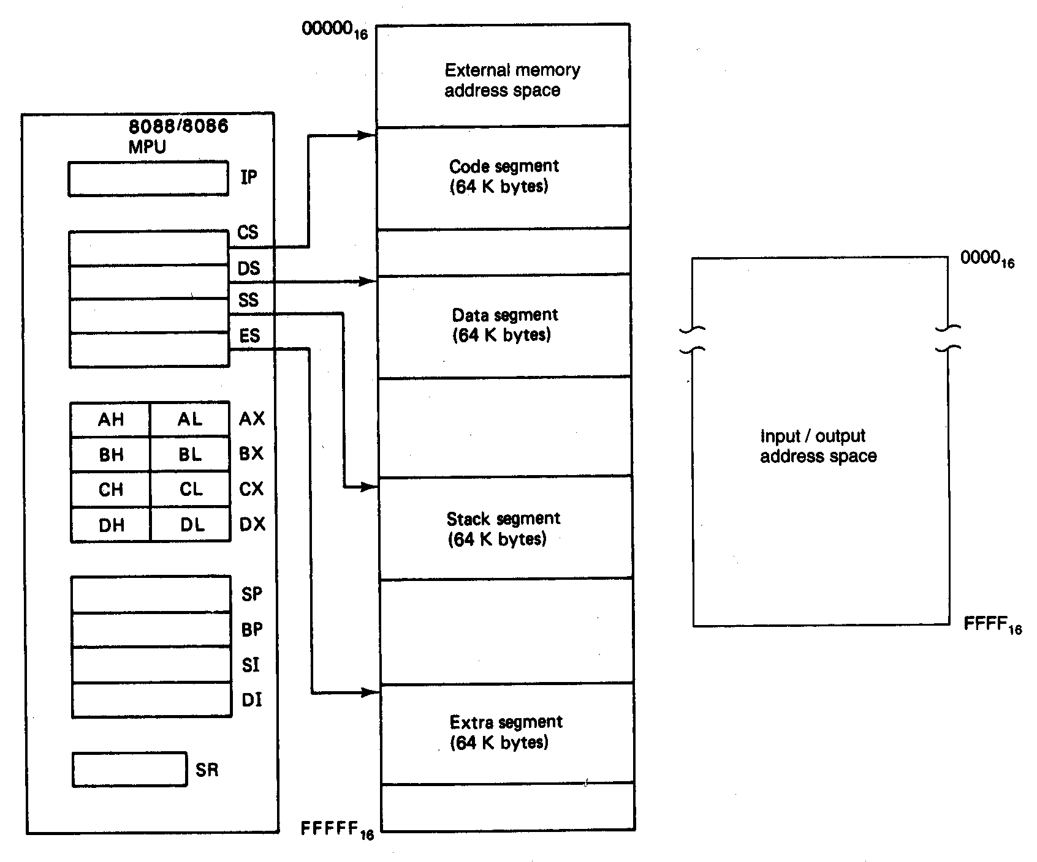
Software Model of the 8086 Microprocessors

Slide 4
Registers
CPU must have some working space (temporary storage)
Called registers
Number and function vary between processor designs
One of the major design decisions
Top level of memory hierarchy
Notes:
23

Slide 5
User Visible Registers
General Purpose
Data
Address
Condition Codes
Notes:
24

Slide 6
General Purpose Registers
May be true general purpose
May be restricted
May be used for data or addressing
Data
  Accumulator
Addressing
  Segment
Notes:
25

Slide 7
General Purpose Registers
Make them general purpose
  Increase flexibility and programmer options
  Increase instruction size & complexity
Make them specialized
  Smaller (faster) instructions
  Less flexibility
Notes:
26

Slide 8
How Many GP Registers?
Between 8 - 32
Fewer = more memory references
More does not reduce memory references and takes up processor real estate
See also RISC
Notes:
27

Slide 9
How big?
Large enough to hold full address
Large enough to hold full word
Often possible to combine two data registers
  C programming
  double int a;
  long int a;
Notes:
28

Slide 10
Condition Code Registers
Sets of individual bits
  e.g. result of last operation was zero
Can be read (implicitly) by programs
  e.g. Jump if zero
Can not (usually) be set by programs
Notes:
29

Slide 11
Control & Status Registers
Program Counter
Instruction Decoding Register
Memory Address Register
Memory Buffer Register
Revision: what do these all do?
Notes:
30

Slide 12
Program Status Word
A set of bits
Includes Condition Codes
Sign of last result
Zero
Carry
Equal
Overflow
Interrupt enable/disable
Supervisor
Notes:
31

Slide 13
Other Registers
May have registers pointing to:
  Process control blocks (see O/S)
  Interrupt Vectors (see O/S)
N.B. CPU design and operating system design are closely linked
Notes:
33

Slide 14
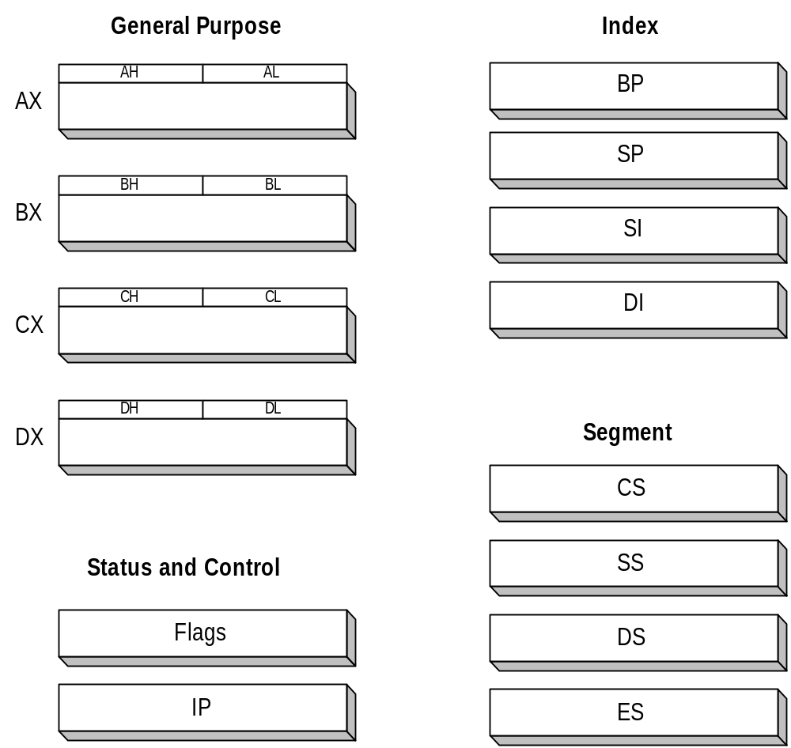
8086 Registers

Slide 15
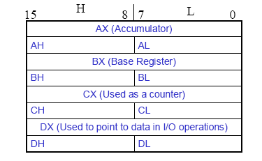
General Purpose Registers-8086
        AX - the Accumulator
        BX - the Base Register
        CX - the Count Register
        DX - the Data Register
Normally used for storing temporary results
Each of the registers is 16 bits wide (AX, BX, CX, DX)
Can be accessed as either 16 or 8 bits AX, AH, AL

Slide 16
General Purpose Registers-8086
AX
  Accumulator Register
  Preferred register to use in arithmetic, logic and data transfer instructions because it generates the shortest Machine Language Code
  Must be used in multiplication and division operations
  Must also be used in I/O operations
BX
  Base Register
  Also serves as an address register

Slide 17
General Purpose Registers-8086
CX
  Count register
  Used as a loop counter
  Used in shift and rotate operations
DX
  Data register
  Used in multiplication and division
  Also used in I/O operations

Slide 18
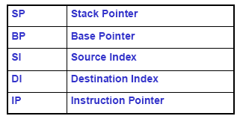
Pointer and Index Registers-8086
All 16 bits wide, L/H bytes are not accessible
Used as memory pointers
  Example: MOV AH, [SI]
    Move the byte stored in memory location whose address is contained in register SI to register AH
IP is not under direct control of the programmer

Slide 19
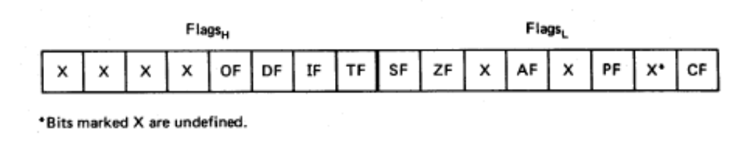
Flag Register-8086
Overflow
Carry
Direction
Parity
Interrupt enable
Auxiliary Carry
Trap
Zero
6 are status flags
3 are control flag
Sign

Slide 20
8086 Programmer’s Model
ES
Extra Segment
_{BIU registers}
_{(20 bit adder)}
CS
Code Segment
SS
Stack Segment
DS
Data Segment
IP
Instruction Pointer
_{EU registers}
AX
AH
AL
Accumulator
BX
BH
BL
Base Register
CX
CH
CL
Count Register
DX
DH
DL
Data Register
SP
Stack Pointer
BP
Base Pointer
SI
Source Index Register
DI
Destination Index Register
FLAGS

Slide 21
The Stack-8086
The stack is used for temporary storage of information such as data or addresses.
When a CALL is executed, the 8086 automatically PUSHes the current value of CS and IP onto the stack.
Other registers can also be pushed
Before return from the subroutine, POP instructions can be used to pop values back from the stack into the corresponding registers.

Slide 22
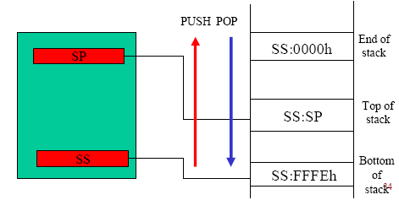
The Stack-8086

Slide 23

Examples: Register Organizations

Slide 24
Instruction format:8086
Instructions are represented in memory by a series of “opcode bytes.”
A variance in instruction size means that disassembly is position specific.
Most instructions take zero, one, or two arguments:
instruction destination, source
For example: add AX, BX
is equivalent to the expression AX = AX + BX
Notes:
Page <number>
In this course, we will only consider 32-bit Intel code.
The number of bytes that make up the opcode of a particular instruction varies, depending on the operands of the instruction.
The first operand (destination) is the one that is modified as a result of the instruction. For example, “add eax, ebx” is equivalent to the expression eax = eax + ebx.

Slide 25
Instruction Formats
Layout of bits in an instruction
Includes opcode
Includes (implicit or explicit) operand(s)
Usually more than one instruction format in an instruction set

Slide 26
Instruction Length
Affected by and affects:
  Memory size
  Memory organization
  Bus structure
  CPU complexity
  CPU speed
Trade off between powerful instruction repertoire and saving space

Slide 27
Allocation of Bits
Number of addressing modes
Number of operands
Register versus memory
Number of register sets
Address range
Address granularity

Slide 28
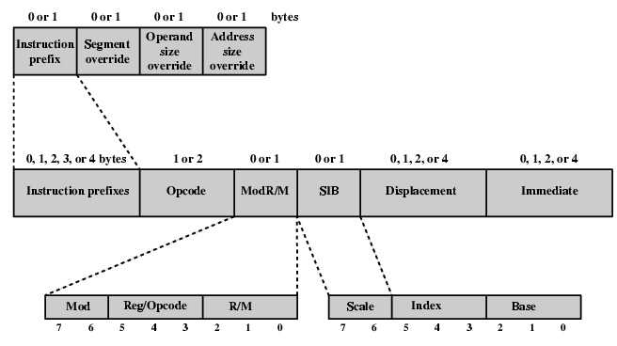
x86 Instruction Format

Slide 29
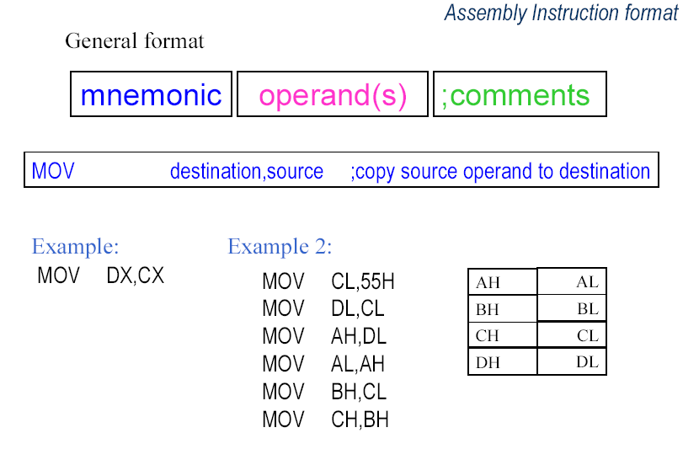
Instruction format:8086

Slide 30
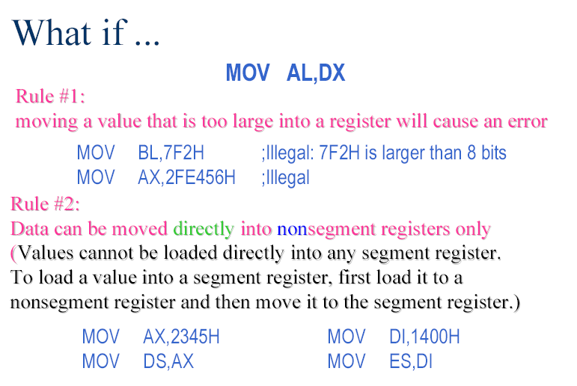
Instruction format:8086
Rule #3:
If a value less than FFH is moved into a 16-bit register, the rest of the
bits are assumed to be all zeros.
MOV BX, 5 BX =0005
BH = 00, BL = 05

Slide 31
Program Segments: Code segment
The 8086 fetches the instructions (opcodes and operands) from the code segments.
The 8086 address types:
  Physical address
  Offset address
  Logical address
Physical address
  20-bit address that is actually put on the address pins of 8086
  Decoded by the memory interfacing circuitry
  A range of 00000H to FFFFFH
  It is the actual physical location in RAM or ROM within 1 MB mem. range
Offset address
  A location within a 64KB segment range
  A range of 0000H to FFFFH
Logical address
  consist of a segment value and an offset address

Slide 32

Program Segments: Code segment
Define the addresses for the 8086 when it fetches the instructions (opcodes and operands) from the code segments.
Logical address:
  Consist of a CS (code segment) and an IP (instruction pointer)
format is CS:IP
Offset address
  IP contains the offset address
Physical address
  generated by shifting the CS left one hex digit and then adding it to the IP
  the resulting 20-bit address is called the physical address

Slide 33
give me some numbers…ok
Program Segments: Code segment
Suppose we have:
CS 2500
IP 95F3
Logical address:
  Consist of a CS (code segment) and an IP (instruction pointer)
format is CS:IP 2500:95F3H
Offset address
  IP contains the offset address which is 95F3H
Physical address
  generated by shifting the CS left one hex digit and then adding it to the IP
    25000 + 95F3 = 2E5F3H

Slide 34
Endian conversion
Little endian conversion:
In the case of 16-bit data, the low byte goes to the low memory location and the high byte goes to the high memory address. (Intel, Digital VAX)
Big endian conversion:
The high byte goes to low address. (Motorola)
Example:
Suppose DS:6826 = 48, DS:6827 = 22,
Show the contents of register BX in the instruction MOV BX,[6826]
Little endian conversion: BL = 48H, and BH = 22H

Slide 35
Addressing Modes
Immediate
Direct
Indirect
Register
Register Indirect
Displacement (Indexed)
Stack
Notes:
2

Slide 36
Immediate Addressing
Operand is part of instruction
Operand = address field
e.g. ADD 5
  Add 5 to contents of accumulator
  5 is operand
No memory reference to fetch data
Fast
Limited range
Notes:
3

Slide 37
Immediate Addressing Diagram
Instruction
Opcode
Operand
Notes:
4

Slide 38
Direct Addressing
Address field contains address of operand
Effective address (EA) = address field (A)
e.g. ADD A
  Add contents of cell A to accumulator
  Look in memory at address A for operand
Single memory reference to access data
No additional calculations to work out effective address
Limited address space
Notes:
5

Slide 39
Direct Addressing Diagram
Instruction
Opcode
Address A
Memory
Operand
Notes:
6

Slide 40
Indirect Addressing (1)
Memory cell pointed to by address field contains the address of (pointer to) the operand
EA = (A)
  Look in A, find address (A) and look there for operand
e.g. ADD (A)
  Add contents of cell pointed to by contents of A to accumulator
Notes:
7

Slide 41
Indirect Addressing (2)
Large address space
2^{n} where n = word length
May be nested, multilevel, cascaded
  e.g. EA = (((A)))
    Draw the diagram yourself
Multiple memory accesses to find operand
Hence slower
Notes:
8

Slide 42
Indirect Addressing Diagram
Instruction
Opcode
Address A
Memory
Pointer to operand
Operand
Notes:
9

Slide 43
Register Addressing (1)
Operand is held in register named in address filed
EA = R
Limited number of registers
Very small address field needed
  Shorter instructions
  Faster instruction fetch
Notes:
10

Slide 44
Register Addressing (2)
No memory access
Very fast execution
Very limited address space
Multiple registers helps performance
  Requires good assembly programming or compiler writing
  N.B. C programming
    register int a;
c.f. Direct addressing
Notes:
11

Slide 45
Register Addressing Diagram
Instruction
Opcode
Register Address R
Registers
Operand
Notes:
12

Slide 46
Register Indirect Addressing
C.f. indirect addressing
EA = (R)
Operand is in memory cell pointed to by contents of register R
Large address space (2^{n})
One fewer memory access than indirect addressing
Notes:
13

Slide 47
Register Indirect Addressing Diagram
Instruction
Opcode
Register Address R
Memory
Registers
Pointer to Operand
Operand
Notes:
14

Slide 48
Displacement Addressing
EA = A + (R)
Address field hold two values
  A = base value
  R = register that holds displacement
  or vice versa
Notes:
15

Slide 49
Displacement Addressing Diagram
Instruction
Opcode
Register R
Address A
Memory
Registers
Pointer to Operand
+
Operand
Notes:
16

Slide 50
Relative Addressing
A version of displacement addressing
R = Program counter, PC
EA = A + (PC)
i.e. get operand from A cells from current location pointed to by PC
c.f locality of reference & cache usage
Notes:
17

Slide 51
Base-Register Addressing
A holds displacement
R holds pointer to base address
R may be explicit or implicit
e.g. segment registers in 80x86
Notes:
18

Slide 52
Indexed Addressing
A = base
R = displacement
EA = A + R
Good for accessing arrays
  EA = A + R
  R++
Notes:
19

Slide 53
CPU Structure
CPU must:
  Fetch instructions
  Interpret instructions
  Fetch data
  Process data
  Write data
Notes:
22

Slide 54
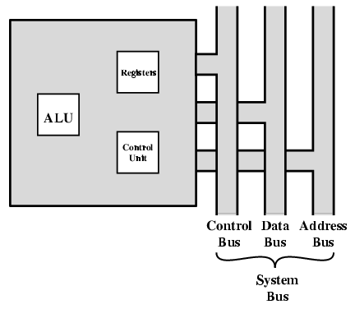
CPU With Systems Bus

Slide 55
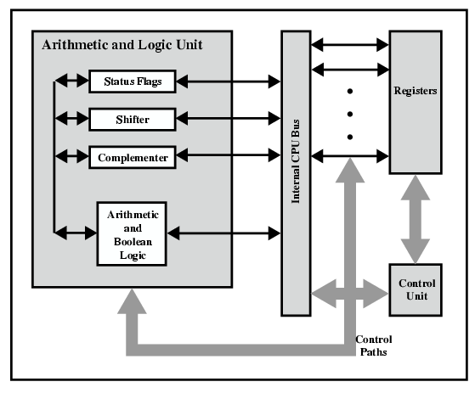
CPU Internal Structure

Slide 56
Indirect Cycle
May require memory access to fetch operands
Indirect addressing requires more memory accesses
Can be thought of as additional instruction subcycle

Slide 57
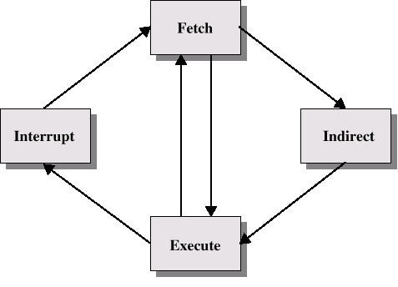
Instruction Cycle with Indirect

Slide 58

Instruction Cycle State Diagram

Slide 59
Data Flow (Instruction Fetch)
Depends on CPU design
In general:
Fetch
  PC contains address of next instruction
  Address moved to MAR
  Address placed on address bus
  Control unit requests memory read
  Result placed on data bus, copied to MBR, then to IR
  Meanwhile PC incremented by 1

Slide 60
Data Flow (Data Fetch)
IR is examined
If indirect addressing, indirect cycle is performed
  Right most N bits of MBR transferred to MAR
  Control unit requests memory read
  Result (address of operand) moved to MBR

Slide 61

Data Flow (Fetch Diagram)

Slide 62

Data Flow (Indirect Diagram)

Slide 63
Data Flow (Execute)
May take many forms
Depends on instruction being executed
May include
  Memory read/write
  Input/Output
  Register transfers
  ALU operations

Slide 64
Data Flow (Interrupt)
Simple
Predictable
Current PC saved to allow resumption after interrupt
Contents of PC copied to MBR
Special memory location (e.g. stack pointer) loaded to MAR
MBR written to memory
PC loaded with address of interrupt handling routine
Next instruction (first of interrupt handler) can be fetched

Slide 65

Data Flow (Interrupt Diagram)

Slide 66
Prefetch
Fetch accessing main memory
Execution usually does not access main memory
Can fetch next instruction during execution of current instruction
Called instruction prefetch
Notes:
36

